Slide 1

ITI - Apache Web Server

Slide 2
Content
1
Web Server Fundamentals
2
Apache
Web Server
3
Apache Components
4
Apache
Demo

Slide 3
Web Server Fundamentals

Slide 4
Web Server Fundamentals
1
How The Website Works?
2
What is DNS?
3
HTTP vs HTTPS
4
HTTP Status Codes
5
Anatomy of Get & Post Requests
6
What’s Web Servers?

Slide 5
Website
User
Browser
Expect to see
Enter a URL
https://www.iti.gov.eg
Request
Translates
domain to IP
DNS Server
Response
Server
Stores or generates website

Slide 6

What’s the DNS?
The Domain Name System (DNS) is the phonebook of the Internet. Humans access information online through domain names, like google.com. Web browsers interact through Internet Protocol (IP) addresses. DNS translates domain names to IP addresses so browsers can load Internet resources.
Each device connected to the Internet has a unique IP address which other machines use to find the device.

Slide 7
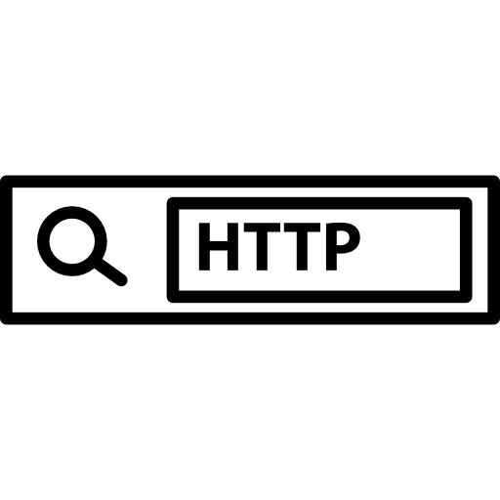
HTTP Definition
Hypertext Transfer Protocol (HTTP) is an application-layer protocol for transmitting hypermedia documents, such as HTML. It was designed for communication between web browsers and web servers.

Slide 8

HTTP | HTTPS
URL begins with http:// | URL begins with https://
The request is processed through port 80 | The request is processed through port 443
Fast transfer of unencrypted data over a simpler protocol | Longer data transfer, as there are additional steps to provide encryption
Main purpose - data exchange on the internet | Main purpose - confidential data exchange
Does not improve search ranking | Improves search ranking

Slide 9
HTTP Methods
GET
Retrieves data from
the server
POST
Submit data to the
server
PUT
Update data already
on the server
Delete
Deletes data from
the server

Slide 10
HTTP Status Codes
1xx : Informational
Request received / Processing
2xx : Success
Successfully received
3xx : Redirect
Further action must be taken
4xx : Client Error
Request doesn’t have what it needs
5xx : Server Error
Server fulfil the request

Slide 11
HTTP Status Codes
200 - Ok
201 - Ok created
301 - Moved to new URL
304 - Not modified (Cached)
400 - Bad request
401 - Unauthorized
404 - Not found
500 - Internal server error

Slide 12
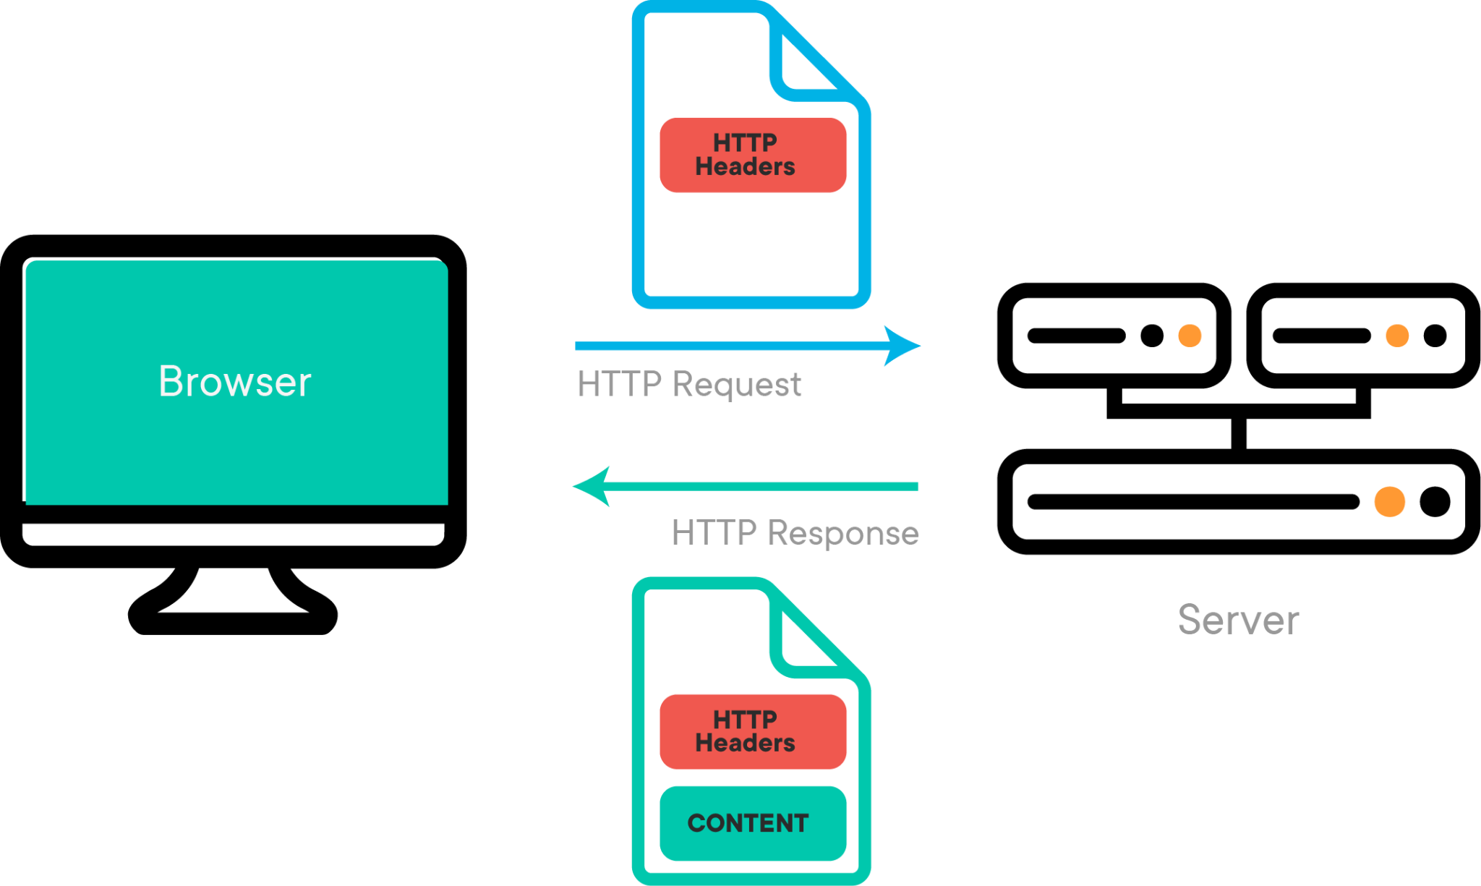

Slide 13
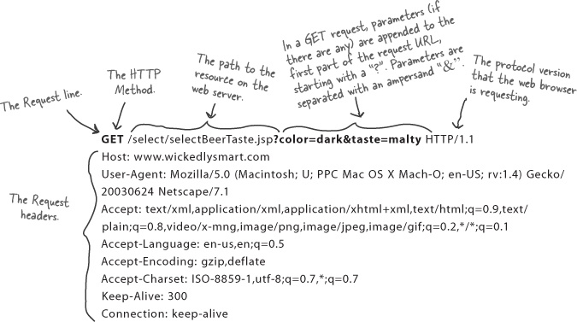
GET Request Anatomy

Slide 14
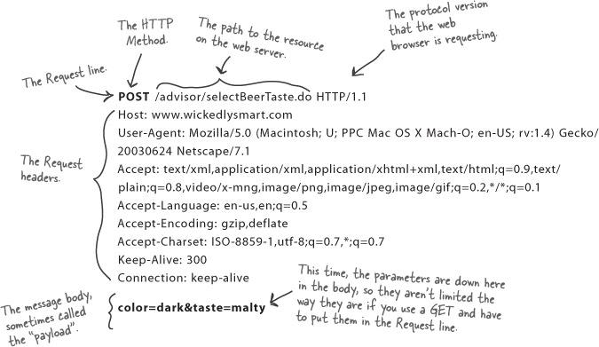
POST Request Anatomy

Slide 15
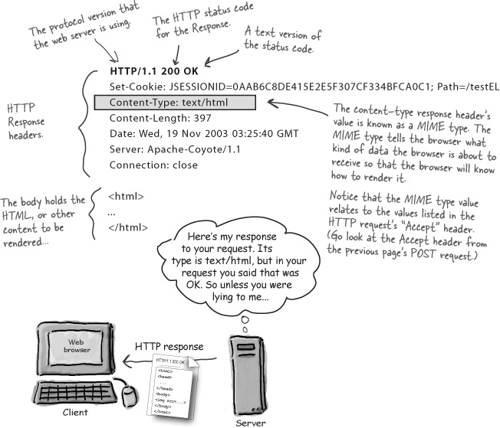
Response Anatomy

Slide 16

What’s Web Server ?
This is a computer that's sole purpose is to distribute information that is hosted within its hard drives.
Depending on the information, it is accessed and distributed differently.
A detailed example would be standard Web Pages that are accessed via the Internet protocol HTTP on port 80 and distributed back in the same fashion which are stored on a web server.

Slide 17
Apache Web Server

Slide 18


Apache History
1994
1995
1999
Developed by Rob McCool at the national center for supercomputing applications
Brian Behlendorf and Cliff Skolnick with others continued the development
Apache Software Foundation formed to provide organizational, legal and financial support for the Apache HTTP server

Slide 19
Apache Web Server
Apache HTTP Server is a free and open-source web server that delivers web content through the internet.
It quickly became the most popular HTTP client on the web. It was revealed that the name originated from the respect of the Native American tribe for its resiliency and durability.

Slide 20

Apache Pros
Open-source and free, even for commercial use.
Reliable, stable software.
Frequently updated security patches.
Flexible due to its module-based structure.
Easy to configure, beginner-friendly.
Cross-platform (works on both Unix and Windows servers).
Optimal deliverability for static files and compatibility with any programming language (PHP, Python.. etc)
Huge community and easily available support in case of any problem.

Slide 21
Apache Cons
Performance problems on extremely traffic-heavy websites.
Too many configuration options can lead to security vulnerabilities.

Slide 22
Apache Components

Slide 23
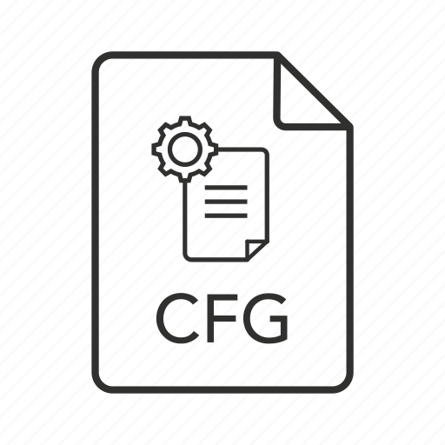
Configuration Files
The Apache HTTP Server is configured via simple text files.
The default configuration file is usually called httpd.conf.
The configuration is frequently broken into multiple smaller files, for ease of management. These files are loaded via the Include directive.

Slide 24
Main Configuration File
Ubuntu:
/etc/apache2/apache2.conf
RedHat or CentOS:
/etc/httpd/conf/httpd.conf

Slide 25

Directives
The server is configured by placing configuration directives in configuration files.
A directive is a keyword followed by one or more arguments that set its value.
In addition to the main configuration files, certain directives may go in .htaccess files located in the content directories.
.htaccess files are primarily for people who do not have access to the main server configuration file(s)

Slide 26
Modules
Modules are service programs that can be dynamically linked and loaded to extend the nature of the HTTP Server.
In this way, the Apache modules provide a way to extend the function of a Web server. Functions commonly added by optional modules include: Authentication, Encryption, Application support, Logging, Diagnostic support.

Slide 27
Public Web Files
Ubuntu:
/var/www/html
RedHat or CentOS:
/var/www/html

Slide 28
Directives Examples
ServerRoot directive
The path to the server’s configuration.
PidFile directive
The process identification number for the httpd registered at starting the server.
ServerName directive
This is where you declare the name of your website.

Slide 29
Directives Examples - Cont.
DocumentRoot directive
This is where your web documents (html files, images etc) should be
located.
Listen directive
The Listen directive instructs Apache httpd to listen to only specific IP
addresses or ports

Slide 30
Directives Contexts
Server config: This means that the directive may be used in the server configuration files (e.g., httpd.conf), but not within any <VirtualHost> or <Directory> containers. It is not allowed in .htaccess files at all.
Virtual host : This context means that the directive may appear inside <VirtualHost> containers in the server configuration files. Directory :A directive marked as being valid in this context may be used inside <Directory>, <Location>, <Files>, and <Proxy> containers in the server configuration files, subject to the restrictions outlined in Configuration Sections.
.htaccess: If a directive is valid in this context, it means that it can appear inside per-directory .htaccess files. It may not be processed, though depending upon the overrides currently active.

Slide 31
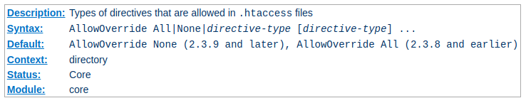
AllowOverride Directive
When the server finds an .htaccess file (as specified by AccessFileName) it
needs to know which directives declared in that file can override earlier
configuration directives.

Slide 32
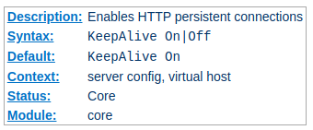
KeepAlive Directive
The Keep-Alive extension to HTTP/1.0 and the persistent connection feature of HTTP/1.1 provide long-lived HTTP sessions which allow multiple requests to be sent over the same TCP connection. In some cases this has been shown to result in an almost 50% speedup in latency times for HTML documents with many images. To enable Keep-Alive connections, set KeepAlive On

Slide 33
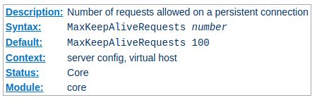
MaxKeepAliveRequests Directive
The MaxKeepAliveRequests directive limits the number of requests allowed
per connection when KeepAlive is on. If it is set to 0, unlimited requests will be allowed. We recommend that this setting be kept to a high value for maximum server performance

Slide 34
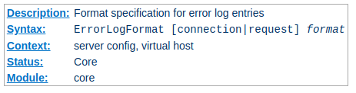
ErrorLog Directive
The ErrorLog directive sets the name of the file to which the server will
log any errors it encounters. If the file-path is not absolute then it is
assumed to be relative to the ServerRoot

Slide 35
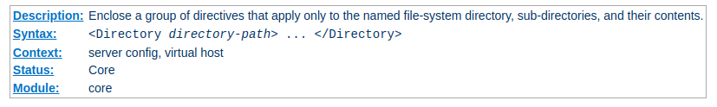
Directory Directive
<Directory> and </Directory> are used to enclose a group of directives
that will apply only to the named directory, sub-directories of that
directory, and the files within the respective directories. Any directive that
is allowed in a directory context may be used.

Slide 36
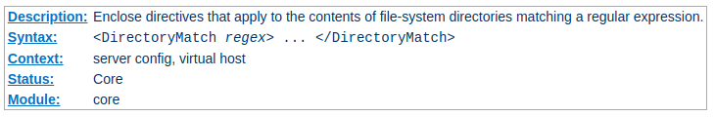
DirectoryMatch Directive
<DirectoryMatch> and </DirectoryMatch> are used to enclose a group of
directives which will apply only to the named directory (and the files within), the same as <Directory>. However, it takes as an argument a regular .expression.

Slide 37
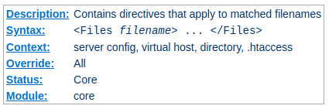
Files Directive
The <Files> directive limits the scope of the enclosed directives by filename. It is comparable to the <Directory> and <Location> directives. It should be
matched with a </Files> directive. The directives given within this section will
be applied to any object with a basename (last component of filename)
matching the specified filename

Slide 38
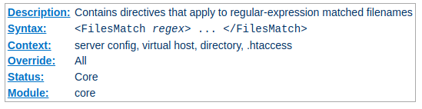
FilesMatch Directive
The <FilesMatch> directive limits the scope of the enclosed directives by
filename, just as the <Files> directive does. However, it accepts a regular
expression.

Slide 39
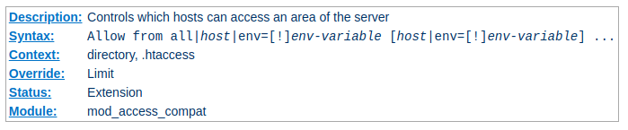
Allow Directive
The Allow directive affects which hosts can access an area of the server. Access can be controlled by hostname, IP address, IP address range, or by other characteristics of the client request captured in environment variables

Slide 40
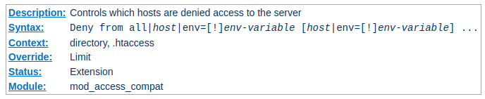
Deny Directive
This directive allows access to the server to be restricted based on hostname, IP address, or environment variables. The arguments for the Deny directive are identical to the arguments for the Allow directive

Slide 41
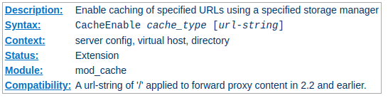
CacheEnable Directive
The CacheEnable directive instructs mod_cache to cache urls at or below url-string. The cache storage manager is specified with the cache_type argument. The CacheEnable directive can alternatively be placed inside either <Location> or <LocationMatch> sections to indicate the content is cacheable

Slide 42
Apache Demo

Slide 43
.htaccess for AUTHENTICATION
.htaccess content
AuthType Basic
AuthName “Restricted web page”
AuthUserFile “/var/www/html/.htpasswd”
require valid-user
To create .htpasswd use this command
htpasswd -c .htpasswd username

Slide 44
.htaccess for AUTHENTICATION
AuthType Basic defines the type of authentication.
Basic means there is no encryption and the password hash is sent as clear text. This is one of the major reasons why .htaccess cannot be considered for protection of confidential user data.
"Restricted web page" is a window title string. When someone tries to access an .htaccess-protected page, a username & password window will pop in the web browser. This window will bear a title - this is the AuthName. It can be anything you like.
AuthUserFile /var/www/.htpasswd defines the path to a file where user credentials are stored. This file does not exist, but we will create it soon.
require valid-user indicates only successful authentication attempts will result in the loading of the page.

Slide 45
Apache Lab
Install Apache HTTP server Create two simple html pages named “page1.html, page2.html” then use the suitable directive to automatically redirect from localhost/page1.html to localhost/page2.html.
Ask for username and password when accessing a directory.
Create a directory then allow access to one of your classmates only.
Disable listing the directory content (hint use indexes)
Change the default index page to be default.html instead of index.html

Slide 46
Thanks!
Do you have any questions?

